Slide 1

DATA ANALYSIS july 2023 by Emmanuel ngongo

Slide 2
PROFESSIONAL BACKGROUND
I am an entry-level software engineer with expertise in data capturing and interpretation, I possess a bachelor’s degree in business information technology with a strong educational background in computer science and experience based on projects in Java, SQL, HTML, CSS, Python, C#, and JavaScript. I am skilled in problem-solving, critical thinking, effective communicator in team environments and I am committed to continuous learning and excited to work on different projects to develop my skills and be a proficient data analyst.

Slide 3
TABLE OF CONTENTS
Professional Background…………………………………………………………………….………………..2
Table of Content…………………………………………………………………………...............................3
Project Udemy…………………………………………………………………………………………………..4
Project Description………………………………………………………………………………………………………..5
Data Design………………………………………………………………………………………...................................6
Findings and Insights ……………………………………………………………………………………………………..8
Action and Recommendations………………………………………………………………………………………..25
Project Data Science Salary…………………………………………………………………………………27
Project Description………………………………………………………………………………………………………..28
Data Design………………………………………………………………………………………………………………..29
Findings and Insight……………………………………………………………………………………………………….30
Action and Recommendation…………………………………………………………………………………………55

Slide 4
Udemy Data Analysis

Slide 5
Project Description
To better understand the pricing and subscriptions data of Udemy courses (for four different subjects) and identifying trends and patterns
This will help us to:
Identify for which subject more courses should be created
Create targeted strategies to increase the company revenue

Slide 6
DATA DESIGN
The Udemy data set was cleaned with google sheets to delete incomplete data and duplicates. Google Sheets and Tableau were used to provide proficient visualization for storytelling, combined with a couple of analytical tools such as pivot tables, IF, and VLOOKUP functions.

Slide 7
KEY QUESTIONS
What are the total numbers of subscribers in each subject?
How does the average content duration/price/number of students vary across different subjects?
How many courses are free and paid for each subject?
What is the average price of web development courses at different levels?
What are the 20 most popular courses? Also, include the following information: - Their level - Whether they are free or paid - Whether any are free beginner courses, - and the duration of the courses.
Does content duration impact the price of the course?

Slide 8
Findings & Insights

Slide 9
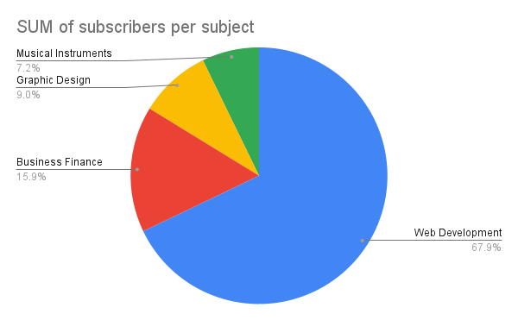
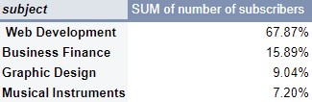
What are the total numbers of subscribers in each subject?

Slide 10
BRIEF SUMMARY
The most popular subject in Udemy is web development and it represents 67.9% of the total subscribers.

Slide 11
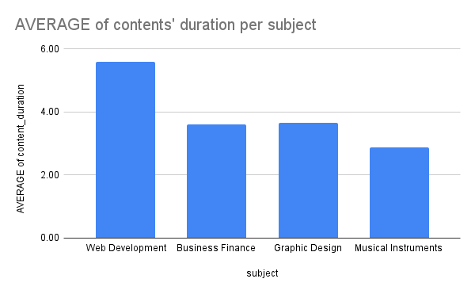
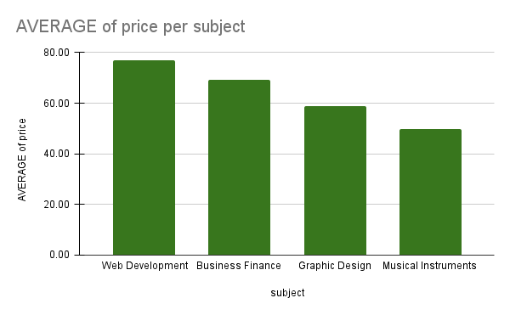
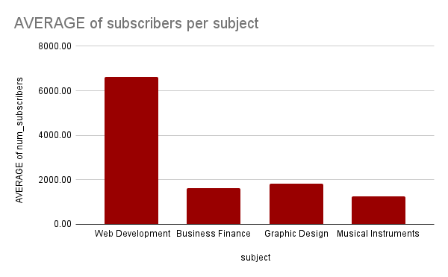
2. How does the average content duration/price/number of students vary across different subjects?

Slide 12
BRIEF SUMMARY
By looking at the column chart for the average content duration, price, and subscribers per subject we have a clear insight into the average price, content duration, and also the number of subscribers, which are the highest for web development.
In the average content duration per subject, graphic design takes second place after web development, while business finance comes third and musical instrument comes last.
By observing the average of price per subject, business finance is the second with an average price of 69.08, graphic design is the third (58.77), and Musical instrument is the last (49.65).
By observing the average of subscribers column graph, we notice that the web development subject has a massive amount of subscribers (6635.02 subscribers) compared to the other subjects, while graphic design has an average of 1617.93 subscribers, followed by business finance which has 1617.93 subscribers and musical instruments subject which has 1265.60 subscribers.

Slide 13
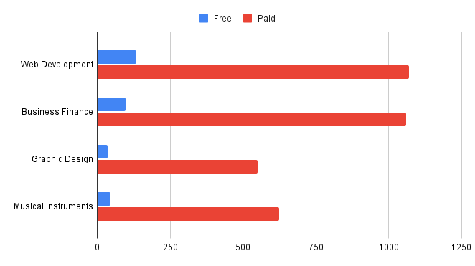
3. How many courses are free and paid for each subject?

Slide 14
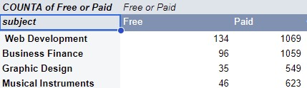
3. How many courses are free and paid for each subject? PIVOT TABLE

Slide 15
BRIEF SUMMARY
Web development and business finance have more courses that are free and paid than the rest.
Web development has a total of 1203 courses which 134 are free and 1069 are paid courses.
Business finance has a total of 1155 courses which 96 are free and 1059 are paid courses.
Graphic design has a total of 584 courses which 549 are paid courses and 35 are free courses.
Musical Instruments has 669 courses in total, made of 46 free courses and 623 paid courses.
Web development and business finance courses represent almost 60% of all courses combined in the database.

Slide 16
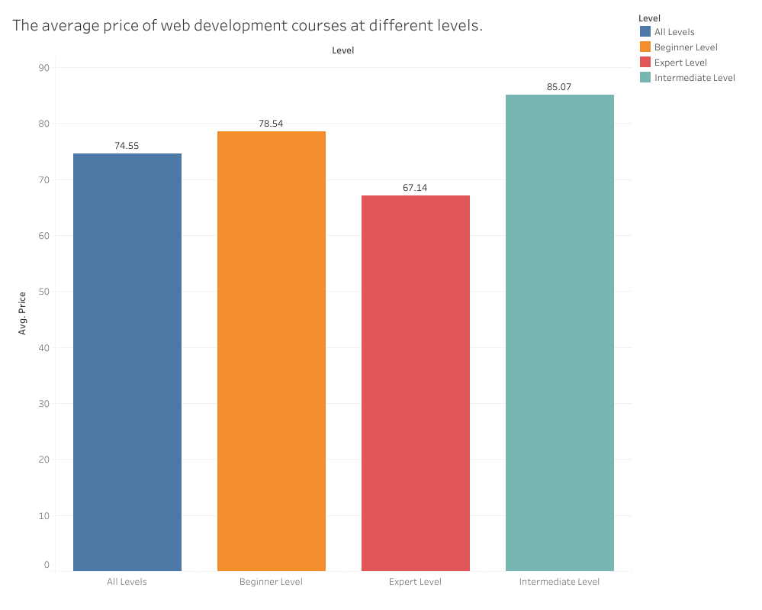
4. What is the average price of web development courses at different levels?

Slide 17
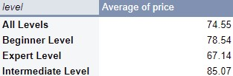
4. What is the average price of web development courses at different levels? PIVOT TABLE

Slide 18
BRIEF SUMMARY
The intermediate level has a higher average price of 85.07 USD, followed by the beginner level with an average price of 78.54 USD, followed by all levels, and the expert level with an average price of 74.55 USD and 67.14 USD.

Slide 19
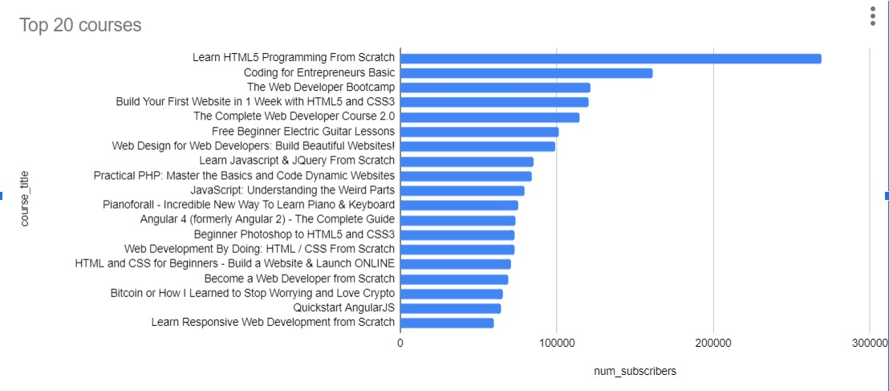
5. What are the 20 most popular courses?

Slide 20
BRIEF SUMMARY
According to the chart, we can notice that the course titled “Learn HTML5 programming from scratch” is the most popular based on the number of 268923 subscribers, followed by “Coding for Entrepreneurs Basic” with 161029 subscribers and the list goes on until the twentieth course “Learn Responsive Web Development from Scratch”.

Slide 21
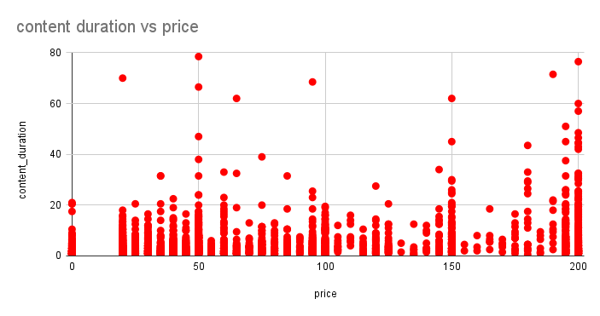
6. Does content duration impact the price of the course?

Slide 22
BRIEF SUMMARY
According to the graph, we can notice that most of the courses have a content duration of 20 hours or less, and a few courses have more than 40 hours of content duration.
The content duration is not affected by the price because we notice there is a course that has a length of 76.50 hours and its price is 200 USD at the same time there is also a course that has a length of 78.50 hours and its price is 50 USD, from these facts we can deduct that the price is not affected by the length of content duration.

Slide 23
Summary

Slide 24
Summary of findings:
Top 5 courses:
Almost 68% of subscribers come from Web Development and the top 5 courses are for Web development as well
Business Finance vs Web Development:
Business Finance and web development have almost equal number of total courses (1155 vs 1203), but web development course are almost 2x in content duration and have 4x the average subscribers
Course Pricing:
The course subscription does not seem to be impacted by the price because web development courses have the highest number of subscribers while having the highest price at the same time.

Slide 25
Actions & Recommendations

Slide 26
Recommended actions
Product recommendations:
Focus on getting more paid course by creators in web development field hence this is the most popular subject in Udemy.
Marketing recommendations:
Our data tells us that our web development courses are the most popular and people are willing to pay for them. Marketing and advertising campaigns should therefore focus on advertising more web development contents.

Slide 27
Data Scientist Salary

Slide 28
PROJECT DESCRIPTION
As an IT graduate, I am fascinated by the huge impact of data science on businesses and how data analysis allows companies to be efficient in marketing and decision-making. Data science has become so important that many companies are willing to invest a huge amount of money, at the same time I am attracted by curiosity to find out how good is the salary for anyone who wishes to start a data science career mostly based in the USA, Canada, and UK.
To do so, this project will focus on understanding the salary of data scientists based on their fields, locations, and expertise.
This will help us to:
Identify which job title in data science has the highest salary.
Which country has the highest and lowest salaries?

Slide 29
DATA DESIGN
To conduct my analysis, I cleaned the original data set downloaded from Kaggle to remove blanks, duplicates, incomplete and irrelevant data.
The dataset was analysed and structured by using Google Sheets and Tableau was used for visualisation, combined with a couple of analytical tools such as formulas, pivot tables, IF, and VLOOKUP functions in order to answer key questions and come up with a conclusion and action recommended according to the findings which will be discussed on the following slides.

Slide 30
KEY QUESTIONS
What is the average salary for different company sizes based on expertise for 2022?
What is the average salary in different countries based on expertise for 2020 to 2023?
Are there any changes in data scientists’ salaries throughout 2022 and 2023?
What is the highest salary for a data scientist?
What is the lowest salary for a data scientist?
Which country has the highest salary in 2023?
What is the most popular data scientist job title in USA, UK And Canada in 2023?
Does the company size affect the salary?

Slide 31
FINDINGS AND INSIGHTS

Slide 32
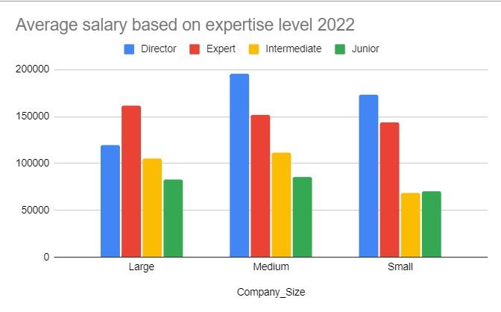
1. What is the average salary for different company sizes based on expertise for 2022?

Slide 33
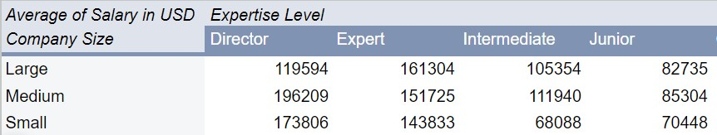
1. What is the average salary for different company sizes based on expertise for 2022? PIVOT TABLE

Slide 34
BRIEF SUMMARY
The average salary for directors is the highest in small and medium companies.
The average salary for experts is the highest within a large company in 2022.
The average salary for intermediate is slightly higher in a large company size.

Slide 35
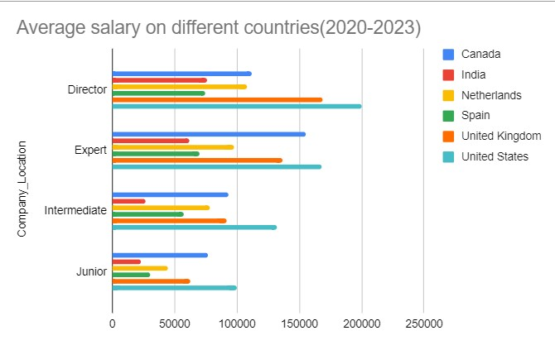
2. What is the average salary in different countries based on expertise for 2020 to 2023?

Slide 36
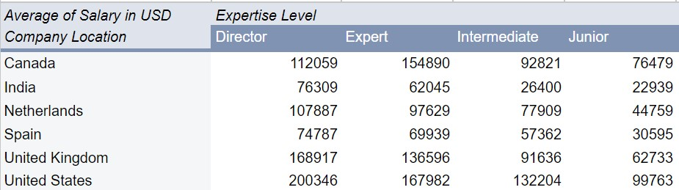
2. What is the average salary in different countries based on expertise for 2020 to 2023? Pivot table

Slide 37
BRIEF SUMMARY
The average salary for directors, experts, intermediate, and junior is the highest in the United States.
The average salary for experts in Canada is 154890$ which comes right after the average salary for experts in the United States.
In the UK, the average salary for directors, intermediates, and juniors comes after the united states’ average.

Slide 38
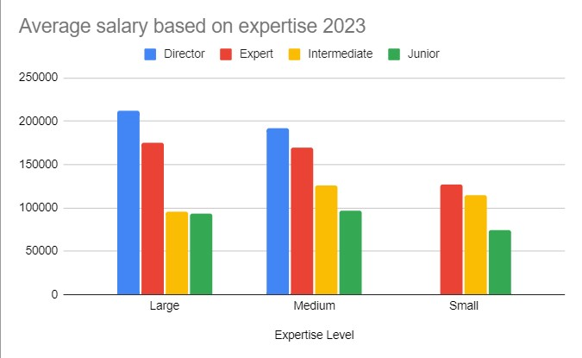
4. Is there any changes in data scientists’ salary throughout 2022 and 2023?

Slide 39
BRIEF SUMMARY
In 2023, the average salary for the directors within large companies has significantly increased and it has decreased in medium-sized companies compared to 2022.
The director’s salary is absent within small companies in 2023.
The experts’ average salary has increased within large and medium companies and it has decreased within small companies in 2023.
The average salary for intermediate has increased within small companies and it has decreased within large companies.

Slide 40
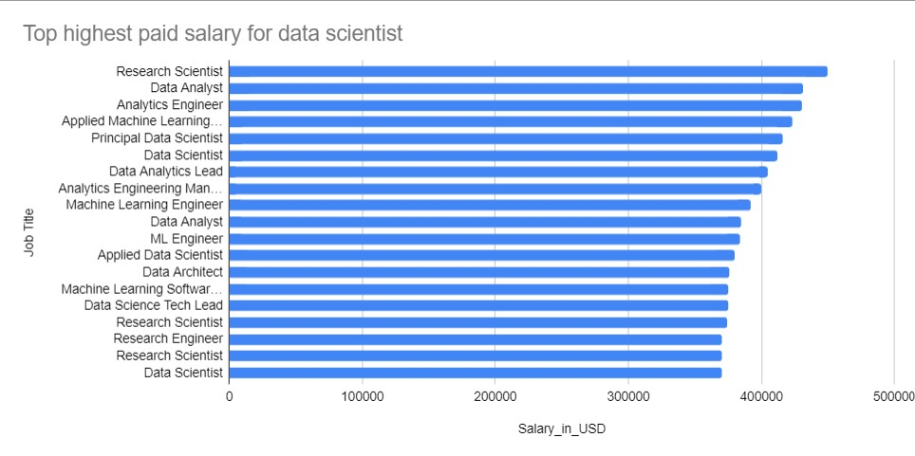
4. What is the highest salary for a data scientist?

Slide 41
BRIEF SUMMARY
The highest paid salary for a data scientist(research scientist) in the dataset collected is precisely 450000$ per year, followed by data analyst job title with a salary of 430967$ per year.

Slide 42
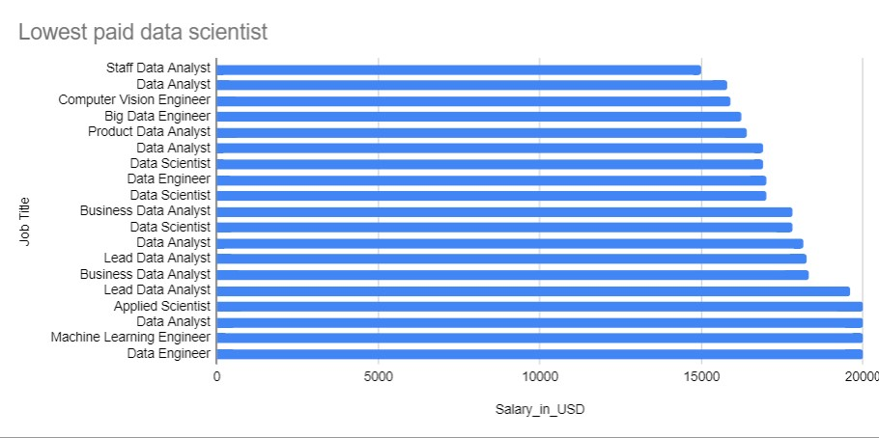
5. What is the lowest salary for a data scientist ?

Slide 43
BRIEF SUMMARY
The lowest paid for a data scientist is 15000$ per year as a staff data analyst.

Slide 44
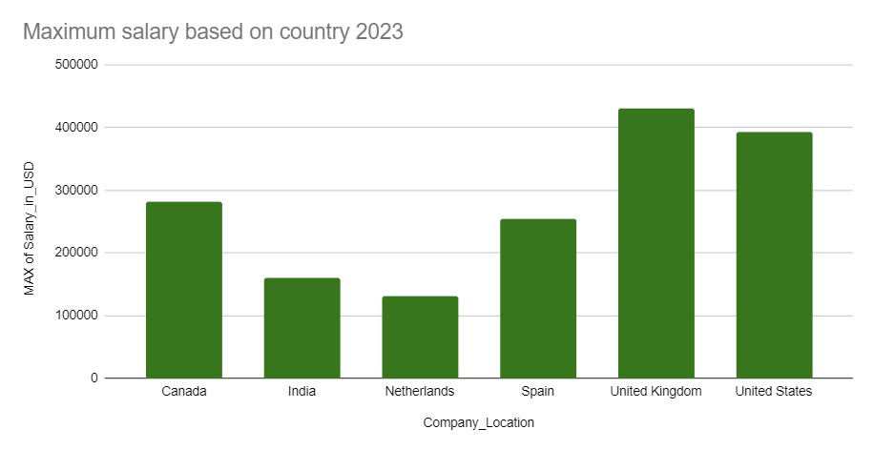
6. Which country has the highest salary in 2023?

Slide 45
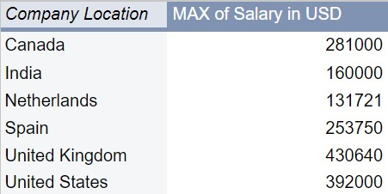
6. Which country has the highest salary in 2023? (Pivot table )

Slide 46
BRIEF SUMMARY
United Kingdom is the country that has the highest salary of 430640$ per year in 2023, followed by the United State with a salary of 392000$ per year, and Canada has the highest salary of 281000$ per year.

Slide 47
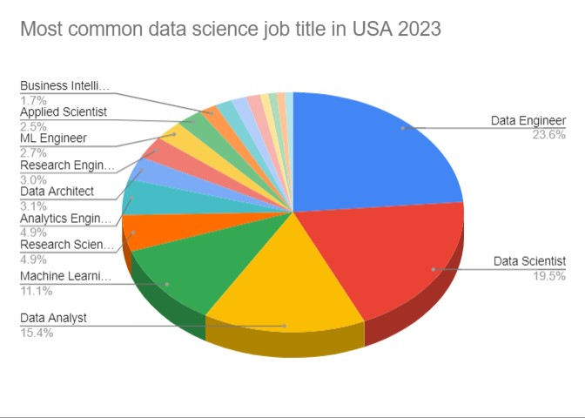
7. What is the most popular data scientist job title in USA, UK And Canada in 2023?

Slide 48
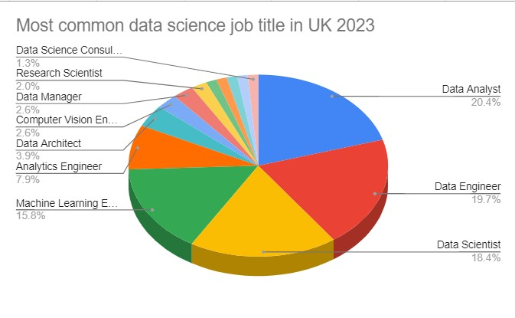
CHART for UK

Slide 49
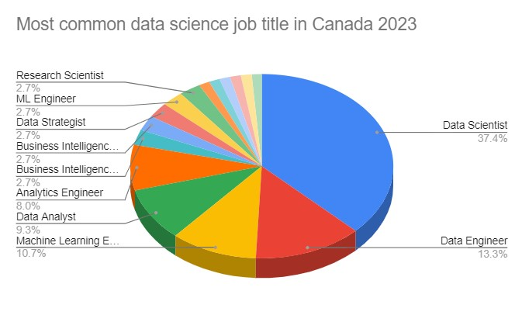
Chart for Canada

Slide 50
BRIEF SUMMARY
In the USA, the most common job title is data engineer which consists of approximately 24% of the total job title.
In the UK, the most common job title is data analyst which consists of 20,4% of the total job title.
In Canada, the most common job title is data scientist which consists of approximately 37% of the total job title in 2023.

Slide 51
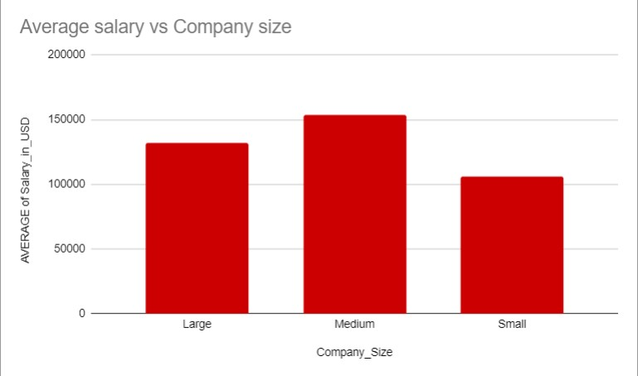
8. Does the company size affect the salary?

Slide 52
BRIEF SUMMARY
The medium size companies appear to offer a higher salary than large and small companies size.

Slide 53
SUMMARY

Slide 54
Summary of findings
Top countries that have high salaries for data science:
In conclusion, the United States has the highest average salary pay rate, followed by the United Kingdom and Canada.
Data scientist’s salary:
As a director or expert data scientist, the salary can get up to 450000$ per year. This can mostly happen when working within large and medium company size in the United States..
Data scientist’s most common job title:
After analysing the most common job titles in the USA, UK, and Canada, we have a clear understanding that data engineer, data scientist, and data analyst are the most repetitive common job title in a data science career.

Slide 55
ACTIONS AND RECOMMENDATIONS

Slide 56
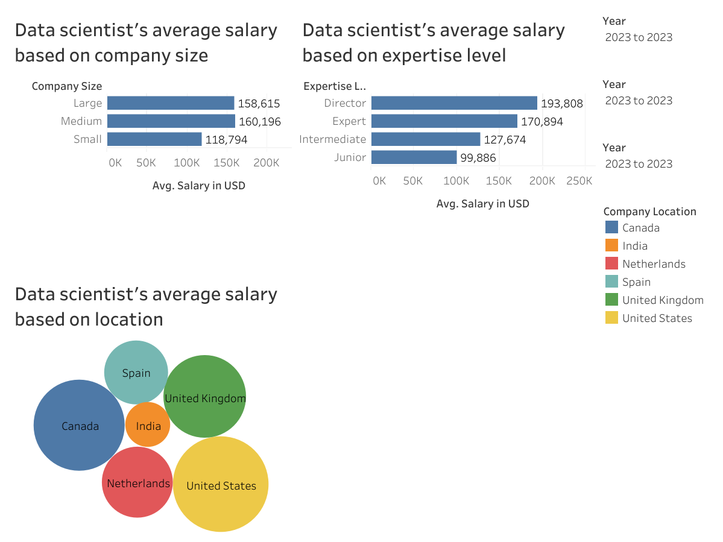
DATA SCIENTIST’S SALARY chart (tableau)

Slide 57
RECOMMENDED ACTIONS:
Our data tells us that anyone who wishes to start a career in data science and looks forward to maximise his or her chance of obtaining a good salary as possible is recommended to achieve an expert level of experience and get a job in a medium-sized company within the united states followed by the United Kingdom and Canada.

Slide 58
THANK YOU

